Slide 1



The Impact of Warehouse Automation in Amazon’s Success

Slide 2

TABLE OF CONTENTS
01. COVER
03. MEET OUR TEAM
04. QUESTION
07. WORKING PROCESS OF AMAZON
15. BUSINESS STRATEGIES

Slide 3







MEET OUR TEAM
Zannatul Ferdous Mim
Tanha
Reja
Sarzila Sahrin Jisha
19-41277-3
19-40151-1
20-42526-1
Alam, Monirul
Rashid, Shihab Ar
19-39971-1
19-41357-3

Slide 4
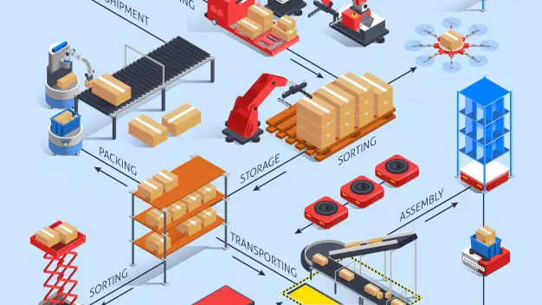
QUESTION
How Smart warehouse management helped Amazon / Alibaba to achieve operation excellence?

Slide 5
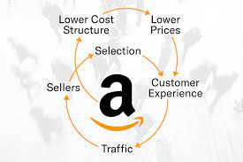
How Smart warehouse management helped Amazon / Alibaba to achieve operation excellence?

Slide 6
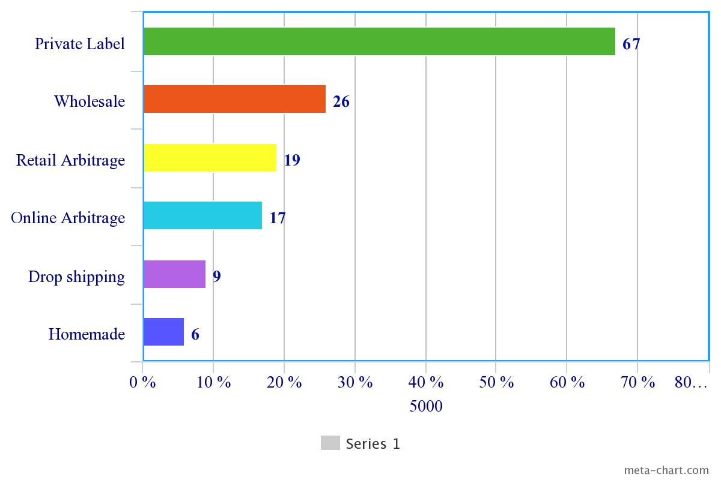
Jungle Scout’s survey of nearly 5,000 Amazon sellers
Jungle Scout’s survey of nearly 5,000 Amazon sellers reveals the breakdown of which business models most Amazon sellers use to sell on Amazon.
* some sellers use more than one business model

Slide 7

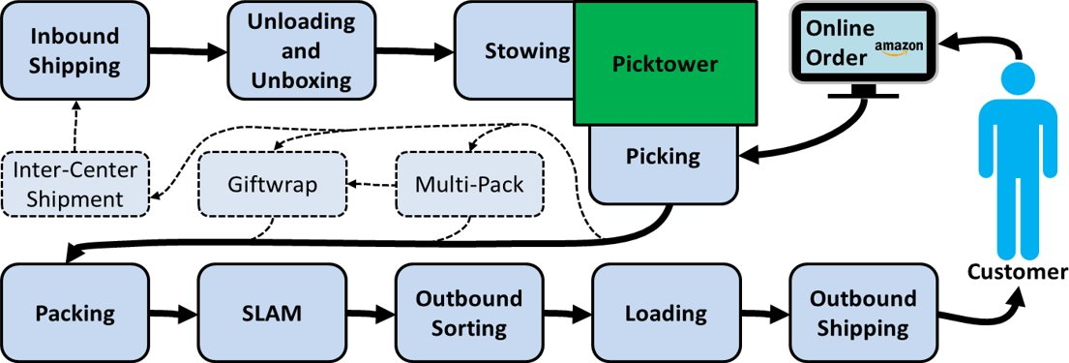
Working Process of AMAZON in the Fulfilment Center
RECEIVING
STOWING
PICKING
PACKING
SLAMING
FLOWING
SHIPPING

Slide 8



Working Process of AMAZON in the Fulfilment Center
Whole process starts from this phase
Items sold on Amazon website
Pick-pack-ship out the items
Barcode scan at conveyer belt
Place items into a black tote
RECEIVING
STOWING
PICKING
PACKING
SLAMING
FLOWING
SHIPPING

Slide 9
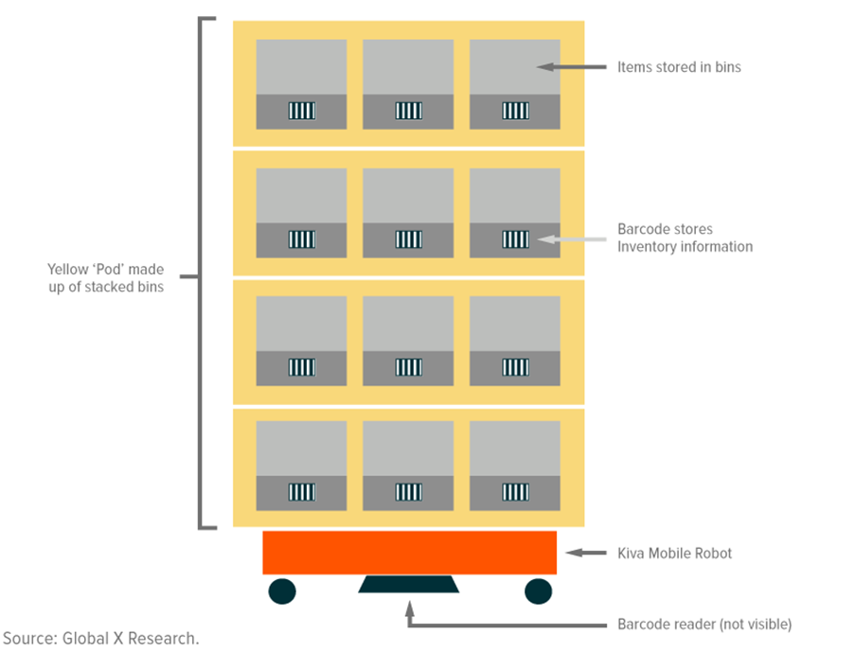
Working Process of AMAZON in the Fulfilment Center
01
Amazon associates stow inbound items in bins that are stacked within yellow towers called ‘PODS’
03
Both pods and the bins have feature barcodes that store information about their contents. So, despite the seeming randomness, computers can instantly locate inventory.
02
Random placement of items
Amazon office supplies, a vendor-sold bike pump, and a Halloween costume could all hypothetically end up in the same bin
04
RECEIVING
STOWING
PICKING
PACKING
SLAMING
FLOWING
SHIPPING

Slide 10
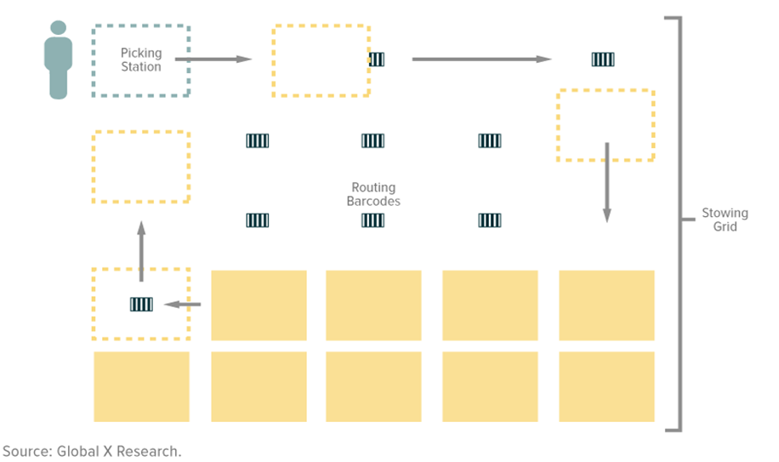
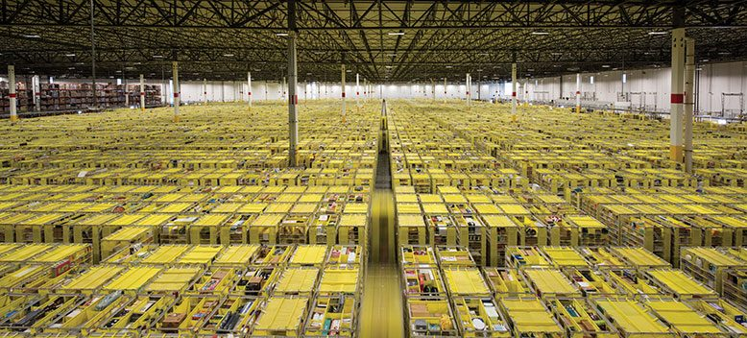
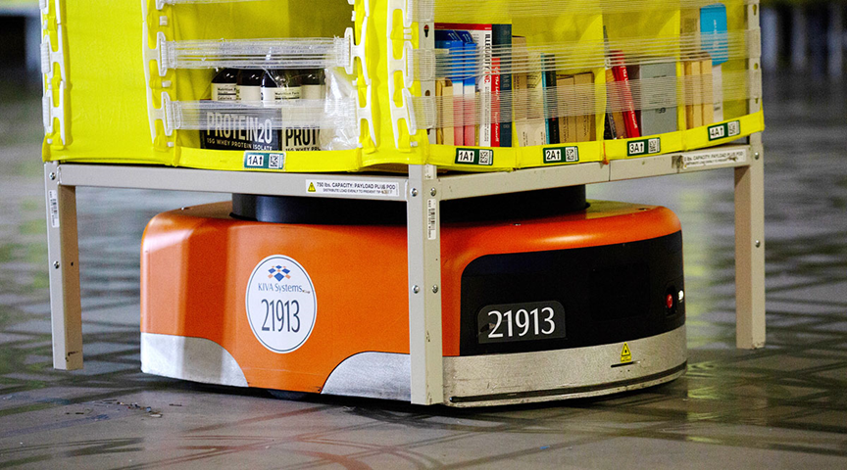
Working Process of AMAZON in the Fulfilment Center
05
Hundreds of pods, each sitting atop a Kiva Mobile Robot are moved autonomously, reading 2D barcodes pasted to the floor that tell them their destination
Kiva Mobile Robot
RECEIVING
STOWING
PICKING
PACKING
SLAMING
FLOWING
SHIPPING

Slide 11
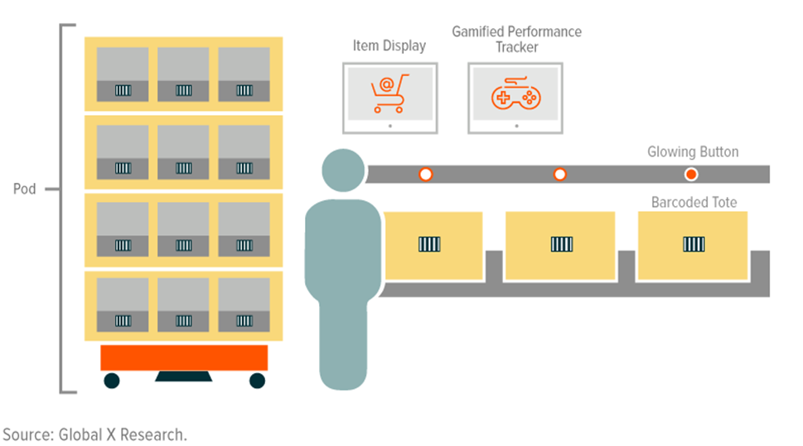
Working Process of AMAZON in the Fulfilment Center
01
An Amazon associate waits in a picking station while a computer monitor displays the item they need to pick from a pod.
02
The pod holding the item arrives at the picking station via a robot, and a projector lights up the exact spot on the pod where the associate will find the item.
When the associate deems a tote as full, they push it on to a conveyor belt and an empty tote automatically replaces it.
03
RECEIVING
STOWING
PICKING
PACKING
SLAMING
FLOWING
SHIPPING

Slide 12
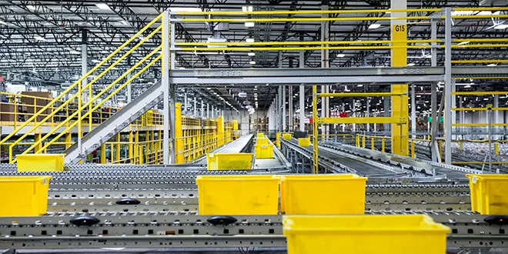
Working Process of AMAZON in the Fulfilment Center
01
Conveyor belts can convey items in a straight line or through elevation and direction changes.
02
03
The parcels may slide down a corkscrew slide to the level of the outgoing loading docks, depending on the sorting floor.
The parcels using a conveyor belt to go to the packing terminal.
RECEIVING
STOWING
PICKING
PACKING
SLAMING
FLOWING
SHIPPING

Slide 13

Working Process of AMAZON in the Fulfilment Center
01
Items arrive at packing stations in totes, ready to be packed by associates.
02
Packers remove items from totes and pack them into boxes and A computer tells them which box size to use.
After filling the box with bubble wrap, packers seal the box, apply bar codes and put it on a conveyer belt.
03
RECEIVING
STOWING
PICKING
PACKING
SLAMING
FLOWING
SHIPPING

Slide 14
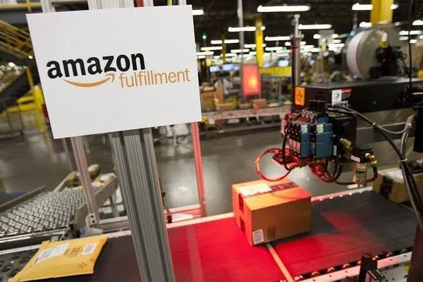
Working Process of AMAZON in the Fulfilment Center
Scanners read barcodes on the boxes and then print labels and paste them on boxes with pinpoint accuracy, all while the conveyor belts maintain rapid speeds.
Scan
Label
Apply
Manifest
RECEIVING
STOWING
PICKING
PACKING
SLAMING
FLOWING
SHIPPING

Slide 15
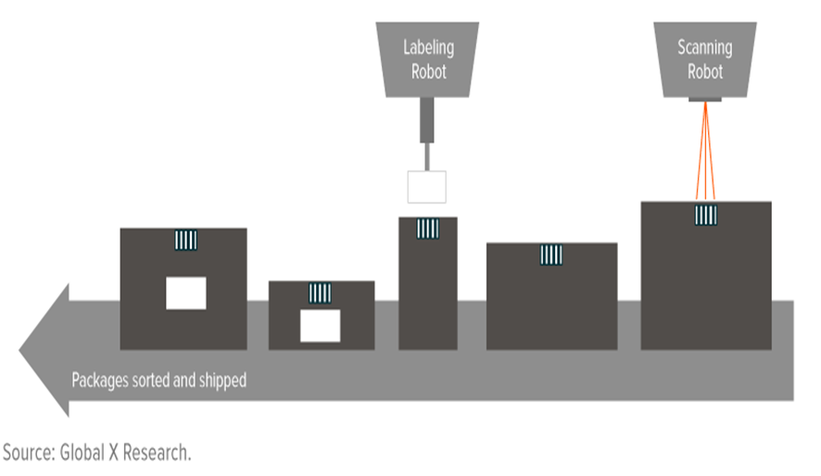

Working Process of AMAZON in the Fulfilment Center
Boxes make their way down the conveyor belt and are automatically sorted by shipping method.
RECEIVING
STOWING
PICKING
PACKING
SLAMING
FLOWING
SHIPPING
Shipment by drones & robots.
Same Day Delivery!

Slide 16

Strategic Business Objectives of Information System
Operational Excellence
New products, services & Business models
Customer and Supplier Intimacy
Improved Decision Making
Survival
Competitive Advantage

Slide 17
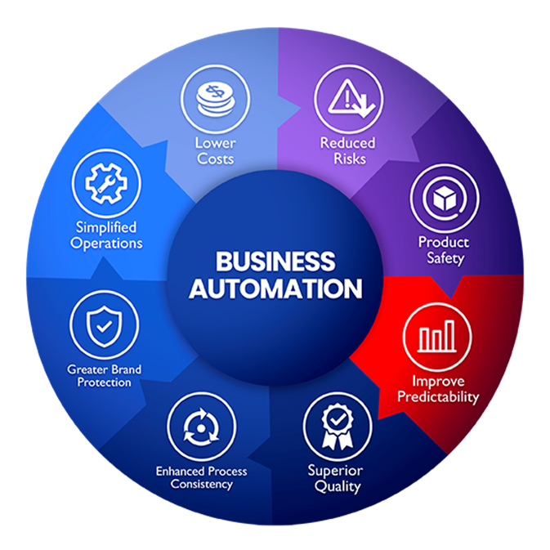
BUSINESS PROCESS AUTOMATION
BENEFITS
01
Improve Efficiency
02
Enhance The Customer Experience
03
Enable Connectivity
04
Promote Collaboration
05
Business Orchestration

Slide 18

COLLABORATION TECHNOLOGY
Improved The Customer Experience
Improved External Collaboration and Communications to enhance vendor/supplier relationships
Facilitated Project Management
Enabled Real-Time Information Exchange to facilitate business processes

Slide 19

THANK YOU

